Slide 1

Master’s of Computer Applications
Project on
ACCIDENT HOTSPOT ANALYSIS
By
Uzma Athar Shaikh - (01FE23MCA059)

Slide 2
STRUCTURE OF PRESENTATION
Introduction
Background study
Research Gap
Problem Statement
Objectives
Technologies used
Modules
Methodology
Results and Discussion
Conclusion and Future work
References

Slide 3
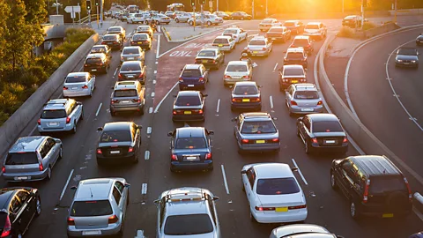
INTRODUCTION
Karnataka experiences a significant number of road accidents every year, resulting in human casualties and economic losses. This project analyzes accident data from 2021 to 2025 across various cities, road types, weather conditions, and vehicle categories. By visualizing trends, hotspots, and severity levels, the dashboard aims to provide actionable insights for improving road safety, enforcing traffic laws, and reducing accident risks.

Slide 4
BACKGROUND STUDY
References | Methodology | Drawbacks
MoRTH, Government of India: Annual reports on road accidents Data source: data.gov.in | Data collected from government portals (2019–2025) Data cleaned and preprocessed (missing values, severity mapping) | Complexity in model integration and may not scale well with larger datasets.
Integrated Road Accident Database (iRAD): Karnataka accident data Data source: iRAD Portal | Analyzed using Python libraries: Pandas, NumPy, Matplotlib, Plotly. | No predictive analytics for accident trends.
Research Paper: Sharma, A., & Singh, R. (2021) – Analysis & Prediction of Road Accidents Using ML | Predicted future trends using Linear Regression | Difficult for authorities to extract actionable insights quickly

Slide 5

RESEARCH GAP
Despite the availability of road accident statistics in Karnataka, most existing reports are static and do not allow for interactive exploration by year, city, or severity. Additionally, very few studies provide predictive insights to forecast future accident trends, limiting their usefulness for preventive planning. City-specific actionable recommendations are often missing, and there is a lack of integrated platforms that combine visualizations, interactive maps, and downloadable reports in a single dashboard. Furthermore, policymakers and traffic authorities cannot easily filter or analyze the data to prioritize safety interventions. This project addresses these gaps by offering an interactive, predictive, and user-friendly dashboard that provides city-level insights and supports informed decision-making.

Slide 6
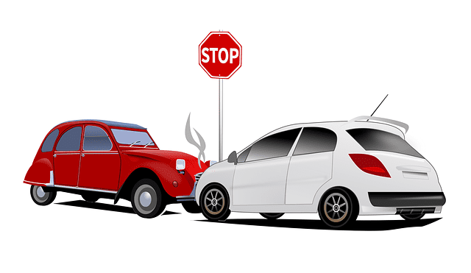
PROBLEM
STATEMENT
Road accidents in Karnataka continue to pose a major public safety challenge, leading to loss of lives, injuries, and economic damage. Despite the availability of accident data, there is a lack of comprehensive analysis that can identify accident hotspots, trends, and high-risk conditions across cities, road types, weather, and vehicle categories. This limits the ability of authorities to implement targeted preventive measures and improve overall road safety.

Slide 7
.
.
OBJECTIVES OF THE PROJECT
Analyze Road Accident Data: Examine accidents in Karnataka from 2021–2025 based on city, severity, weather, road type, and vehicle type.
Identify Accident Hotspots: Map high-risk locations to help authorities prioritize interventions.
Visualize Trends & Patterns: Provide interactive charts and graphs for yearly, seasonal, and daily accident trends.
Provide City-Specific Insights: Highlight top risk factors and recommend targeted safety measures.
Enable Predictive Analysis: Forecast future accident trends using historical data for proactive planning.
Generate Reports: Allow download of CSV and PDF reports for decision-making and documentation

Slide 8
TECHNOLOGIES USED
Software Requirements:
Hardware Requirements:
Frontend / UI: Streamlit, HTML, CSS
Backend / Data Processing: Python, Pandas, NumPy, Scikit-learn
Visualization & Mapping: Matplotlib, Plotly, Folium
Reporting & Export: ReportLab (PDF), CSV
Development Approach: Agile methodology for iterative development
Processor: Intel Core i5 or higher
RAM: 8 GB or more
Storage: Minimum 100 GB HDD/SSD
Operating System: Windows 10/11, Linux, or macOS
Internet: Required for map tiles and data downloads

Slide 9

MODULES OF THE PROJECT
1. Login & Authentication Module
2 Data Loading & Preprocessing Module
3. Filter & Selection Module
4. Visualization Module
5. Accident Mapping Module
6. City-Specific Insights Module
7. Comparative Analysis Module
8. Predictive Analysis Module
9. Report Generation & Download Module

Slide 10
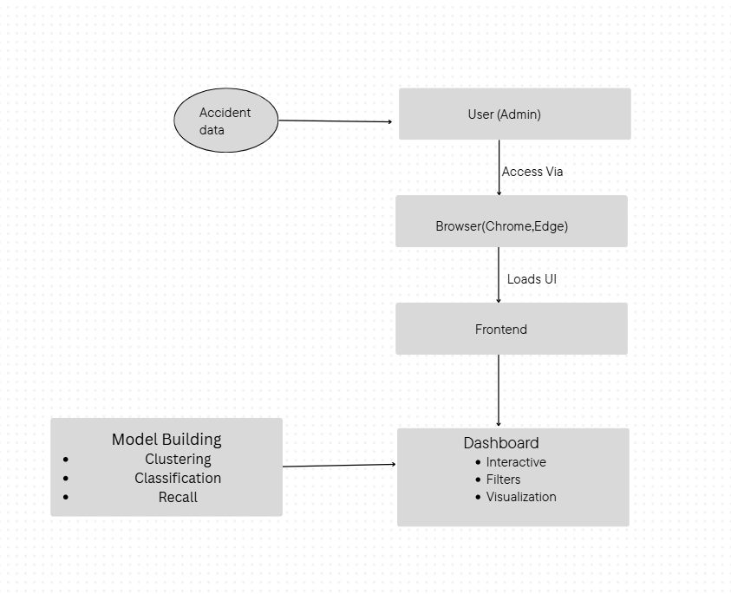
System architecture diagram

Slide 11
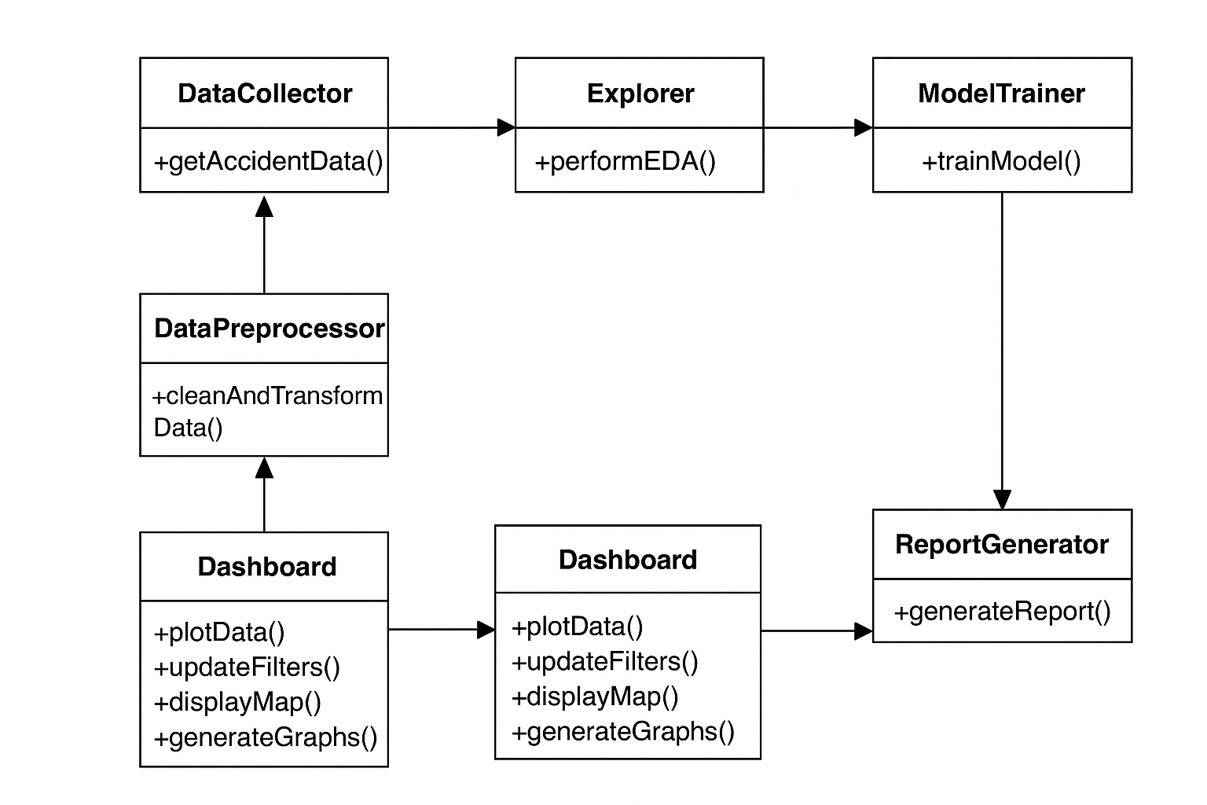
UML Diagram

Slide 12
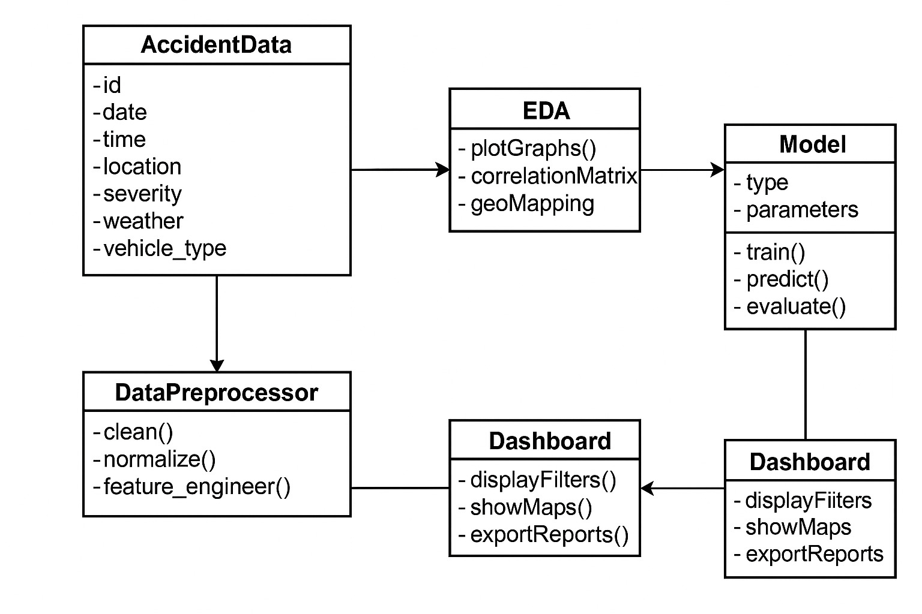
WORK FLOW DIAGRAM

Slide 13
METHODOLOGY
Requirement Analysis: Identify goals, key metrics, and dashboard features.
Data Collection: Gather Karnataka accident data (2021–2025) with all relevant details.
Data Cleaning & Preprocessing: Handle missing values and create derived features.
Visualization & Mapping: Interactive charts and maps for trends, severity, and hotspots.
City-Specific Insights & Recommendations: Highlight risk factors and suggest preventive measures.
Predictive Analysis & Reporting: Forecast trends using Linear Regression and generate PDF/CSV reports.

Slide 14
RESULTS AND DISCUSSIONS
Accident Overview: Total accidents, fatal & severe accidents, average casualties.
Yearly & Severity Trends: Bar charts showing trends over years; severity distribution (Minor, Moderate, Severe, Fatal).
Accident Mapping: Interactive markers, clusters, and heatmaps to identify accident hotspots.
Weather, Road & Vehicle Analysis: Correlation of accidents with weather, road types, and vehicle types.
Time & Day Analysis: Peak accident hours (morning/evening) and high-risk days of the week.
City-Specific Insights: Top contributing weather, road, and vehicle types; suggested safety measures.
Predictive Analysis: Linear Regression forecast for next year’s accidents to support proactive planning.
Discussion: Dashboard enables interactive exploration, identifies trends, assists policymakers; predictions are based on historical data and may not account for sudden changes.

Slide 15
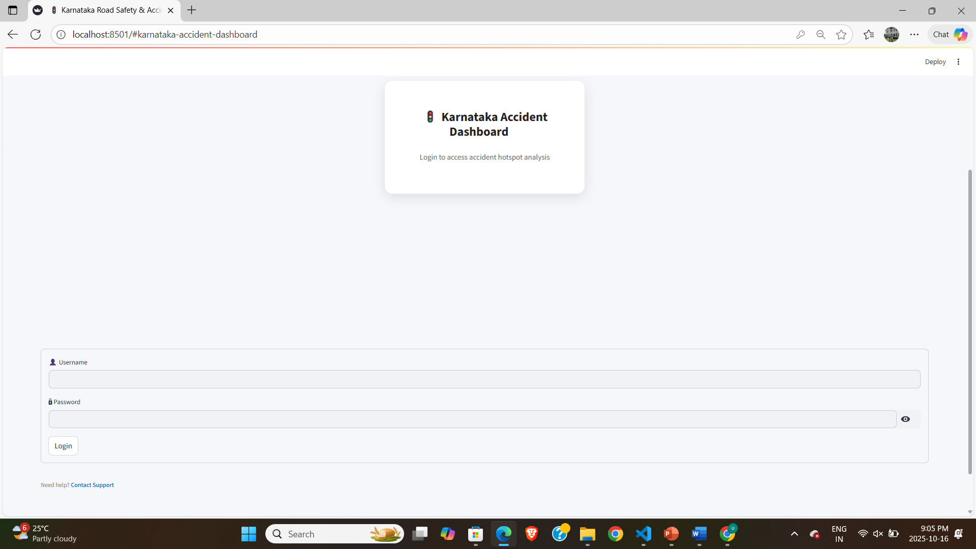
LOGIN PAGE

Slide 16
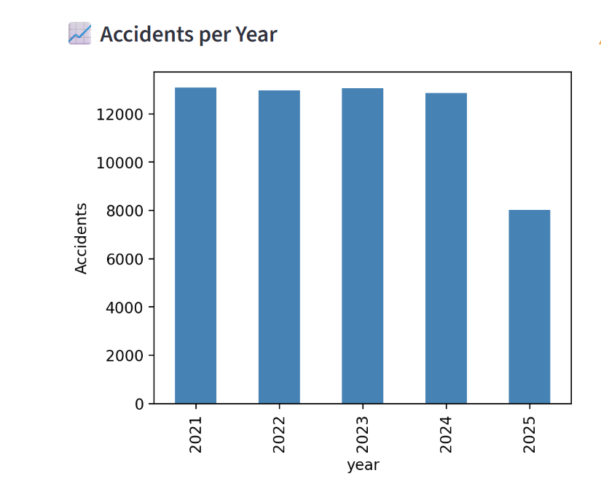
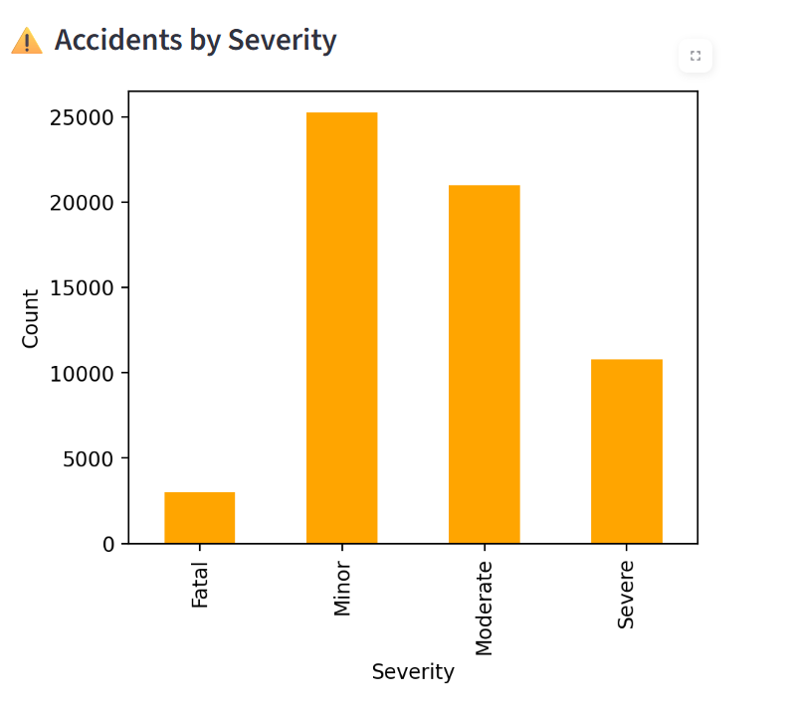
DASHBOARD

Slide 17
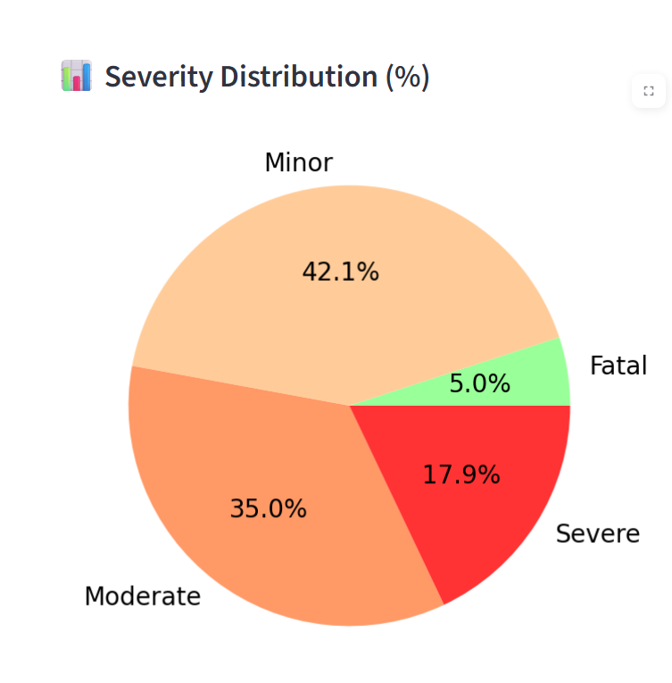
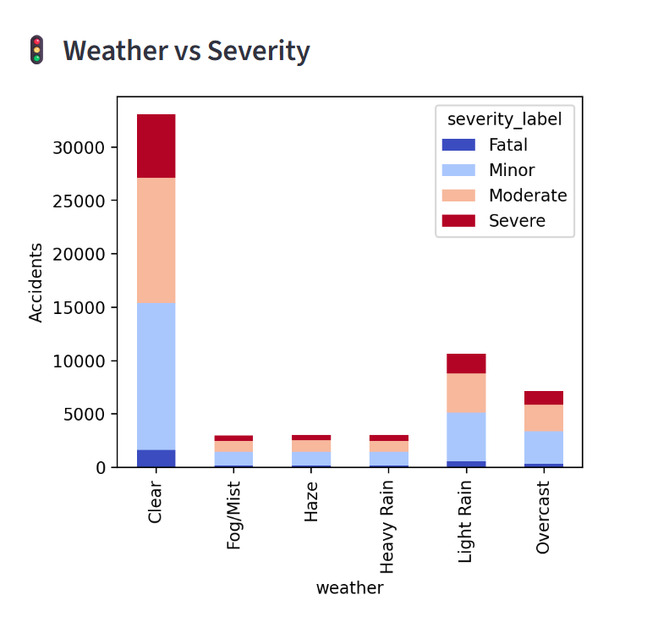
DASHBOARD

Slide 18
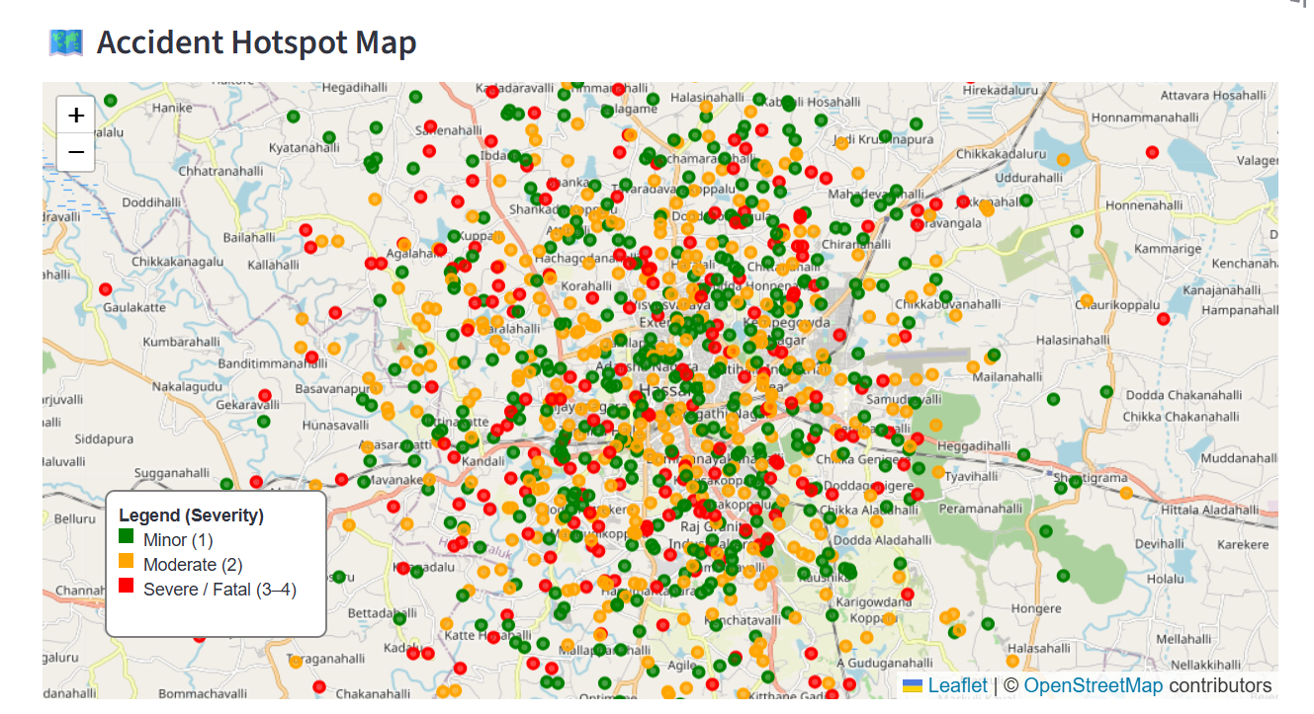
DASHBOARD
Markers
UPCOMING EVENTS

Slide 19
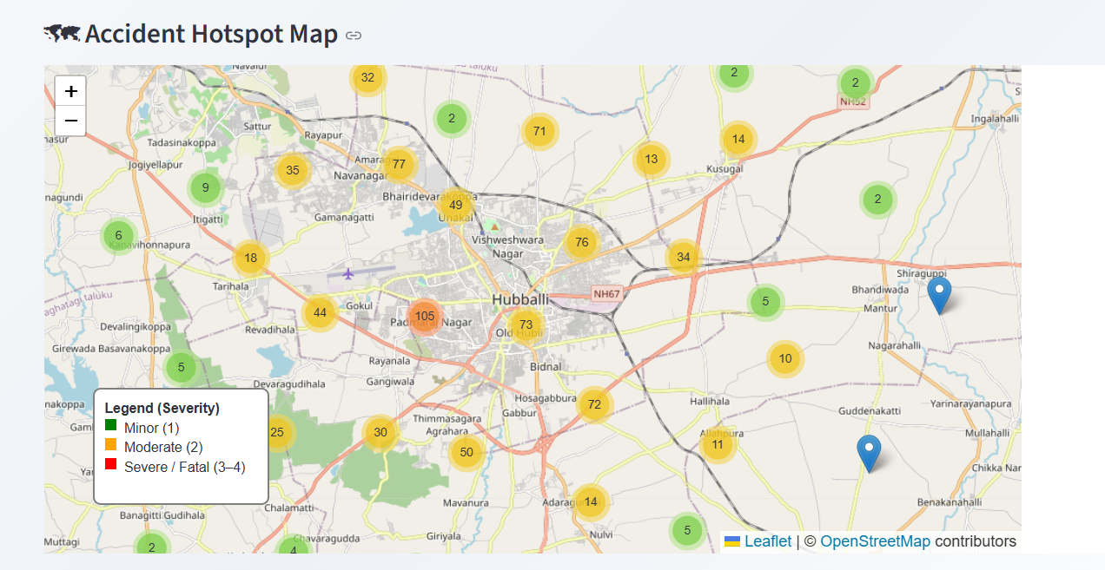
DASHBOARD
Clusters

Slide 20
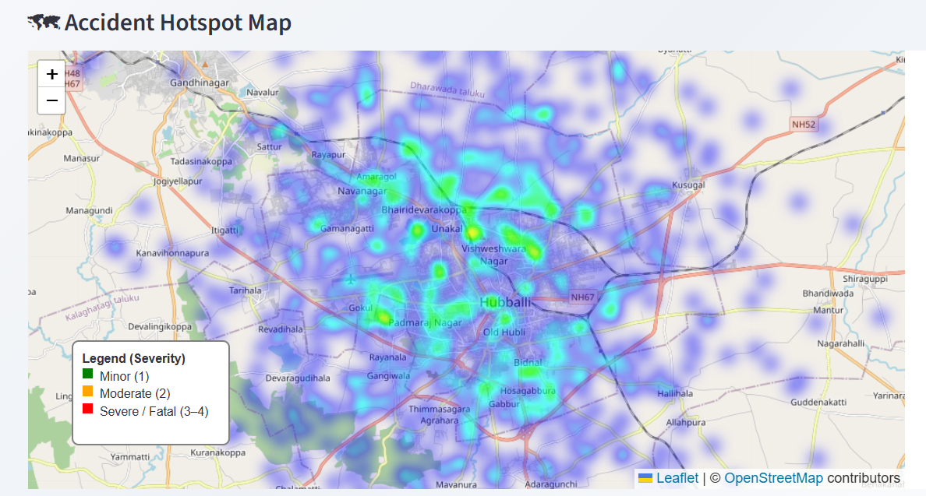
DASHBOARD
Heat Map

Slide 21
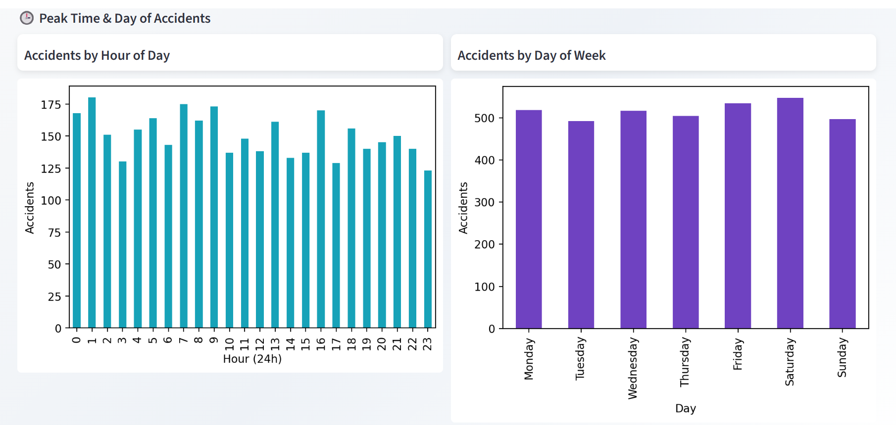
DASHBOARD
UPCOMING EVENTS

Slide 22
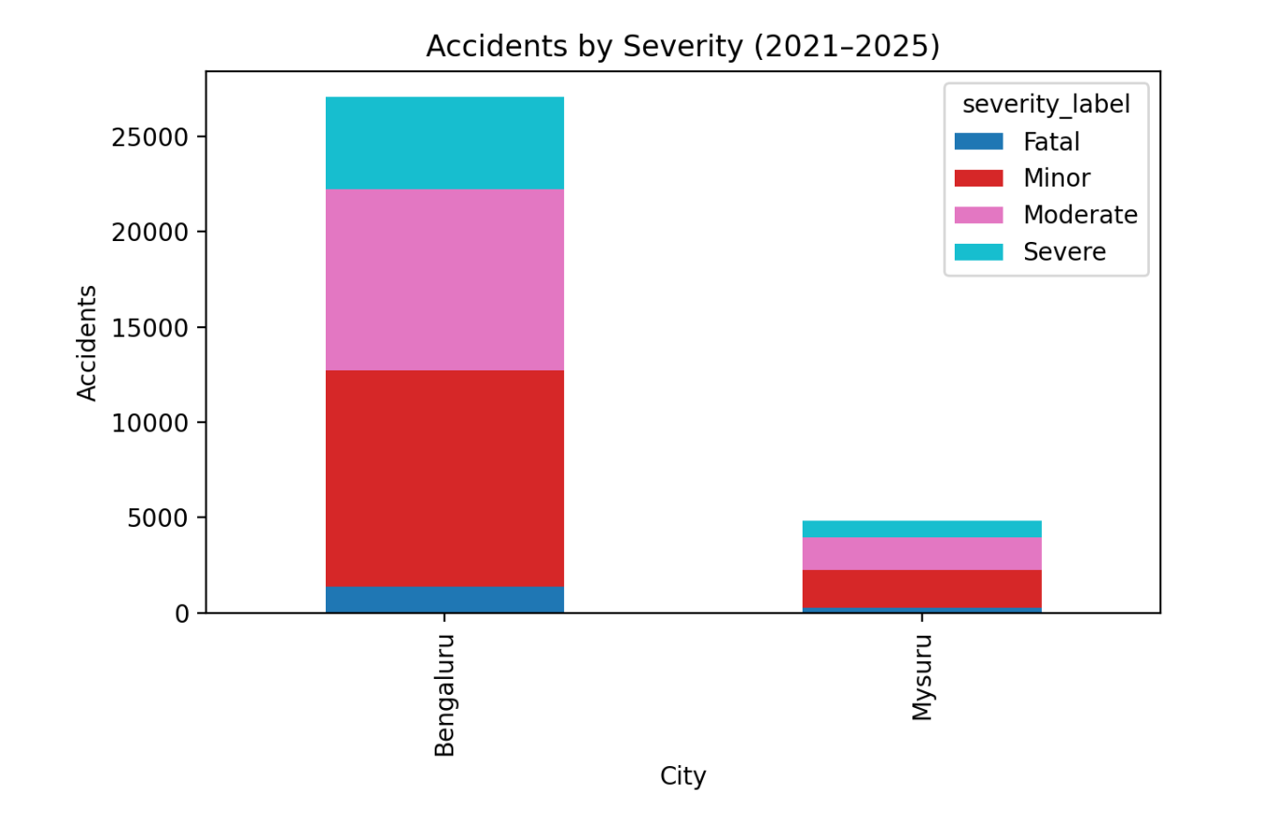
DASHBOARD
📊City Comparison (2021–2025)

Slide 23
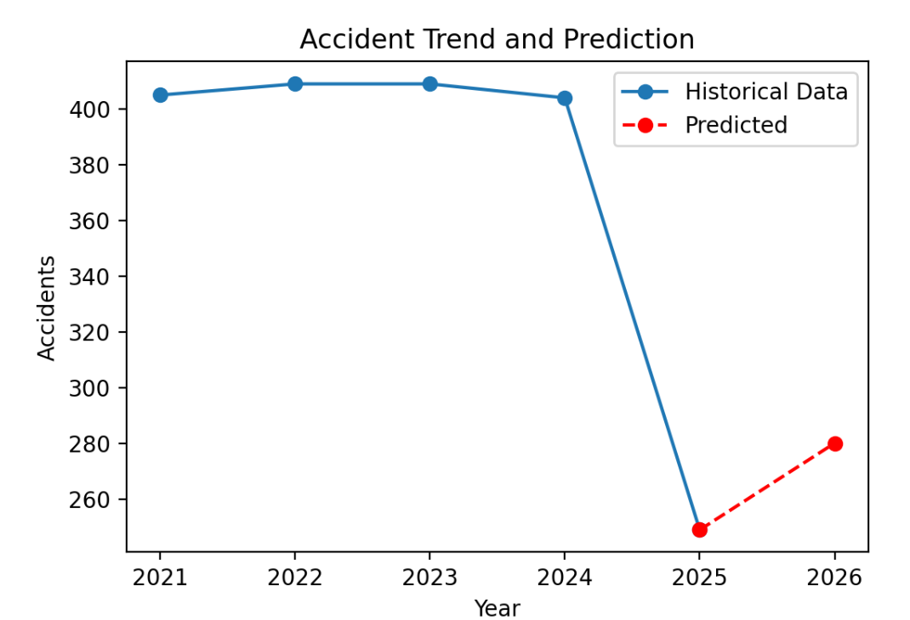
DASHBOARD
📈 Future Accident Prediction (Simple Trend Forecast)

Slide 24
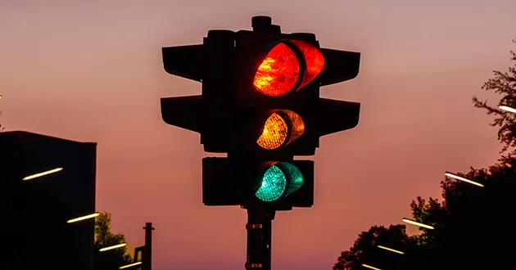
Conclusion:
The Karnataka Road Accident Dashboard offers an interactive platform to analyze accident trends, hotspots, and severity from 2021–2025. With city-specific insights, predictive analysis, and downloadable reports, it helps authorities make data-driven decisions to improve road safety and reduce casualties.

Slide 25
Future Work
Integration with Real-Time Data: Connect dashboard to live traffic and accident feeds for up-to-date analysis.
Advanced Predictive Models: Use Machine Learning (e.g., Random Forest, XGBoost) for more accurate accident predictions.
Mobile-Friendly Dashboard: Develop a responsive version for tablets and smartphones for easy access by authorities.
Automated Alerts & Notifications: Alert traffic police or emergency services about accident-prone zones or unusual trends.
Enhanced Visualization: Add interactive heatmaps, 3D maps, and temporal animations for deeper insights.
Expanded Data Sources: Include hospital, insurance, and vehicle registration data to analyze accident causes more comprehensively.

Slide 26
REFERENCES
K. Katoch and R. G. Tiwari, "Machine Learning-Based Classification of Road Accident Severity in India: A Comparative Analysis of Algorithms," 2023 14th International Conference on Computing Communication and Networking Technologies (ICCCNT), Delhi, India, 2023, pp. 1-5, doi: 10.1109/ICCCNT56998.2023.10308335.
J. Xi, S. Wang, Chen Xiaodong and Zhurongtao, "Accident cause analysis method based on traffic accident information system," 2010 International Conference on Computer Application and System Modeling (ICCASM 2010), Taiyuan, 2010, pp. V13-230-V13-233, doi: 10.1109/ICCASM.2010.5622735.
M. F. Labib, A. S. Rifat, M. M. Hossain, A. K. Das and F. Nawrine, "Road Accident Analysis and Prediction of Accident Severity by Using Machine Learning in Bangladesh," 2019 7th International Conference on Smart Computing & Communications (ICSCC), Sarawak, Malaysia, 2019, pp. 1-5, doi: 10.1109/ICSCC.2019.8843640.
S. Subhashini and R. Maruthi, "A Predictive Model for Road Traffic Data Analysis and Visualization to Detect Accident Zones," 2023 9th International Conference on Advanced Computing and Communication Systems (ICACCS), Coimbatore, India, 2023, pp. 1227-1231, doi: 10.1109/ICACCS57279.2023.10112862.
C. Wenxue, W. Hengpeng, S. Shangjiang and A. Lilu, "An improved hazardous material road transportation accident rate analysis model," 2010 International Conference on Logistics Systems and Intelligent Management (ICLSIM), Harbin, China, 2010, pp. 1081-1085, doi: 10.1109/ICLSIM.2010.5461123.

Slide 27
THANK YOU

